Slide 1

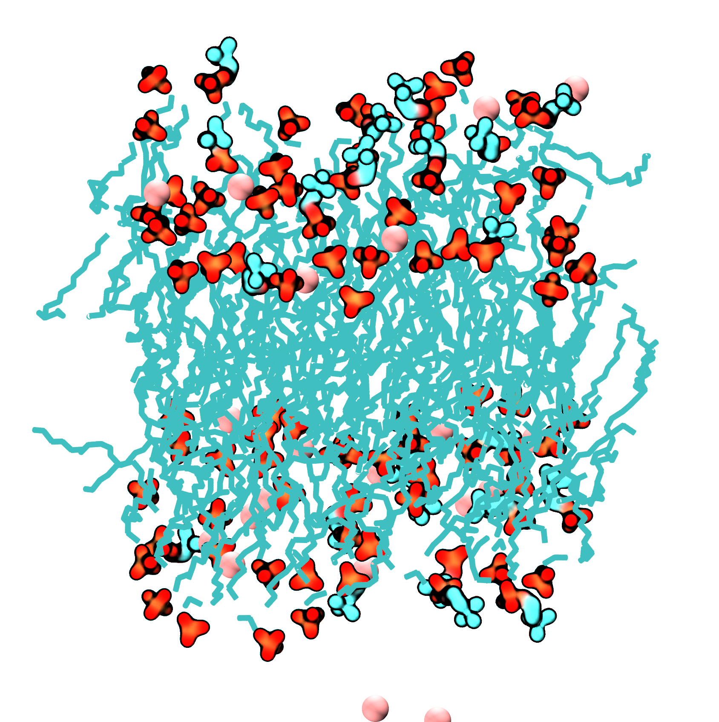
Improving CHARMM36 force field for lipid interactions
with Ca²⁺ and Be²⁺ using Free Energy Perturbation
Jessica Bodosa
Biophysics program
Klauda Lab

Slide 2
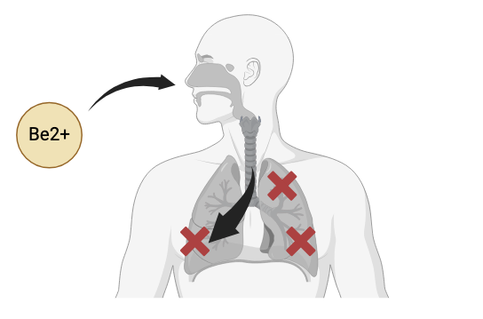
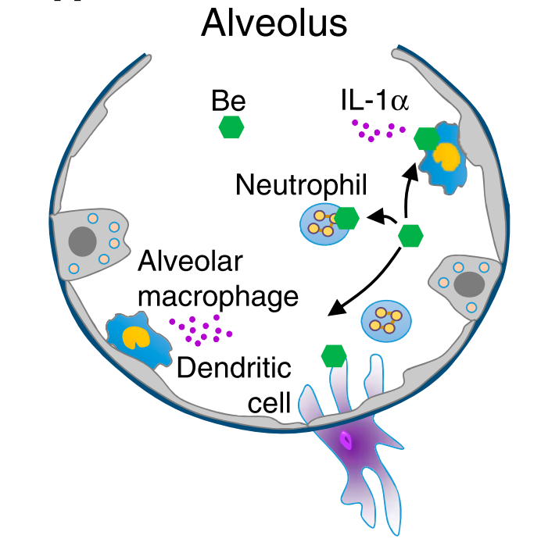
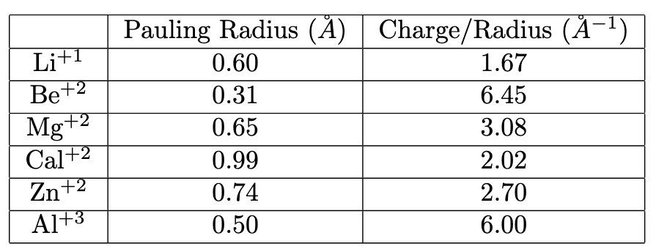
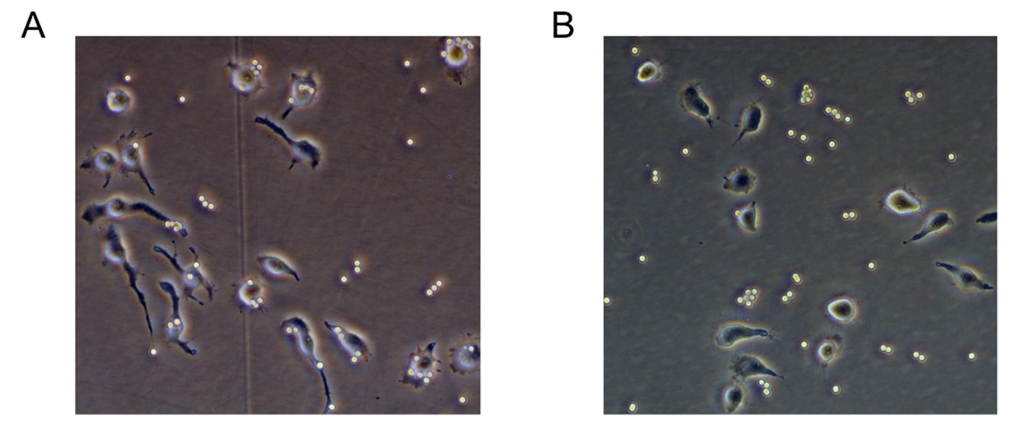
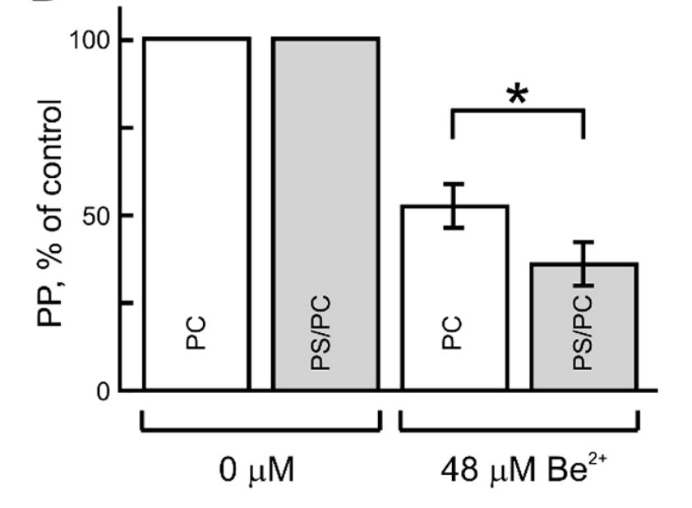
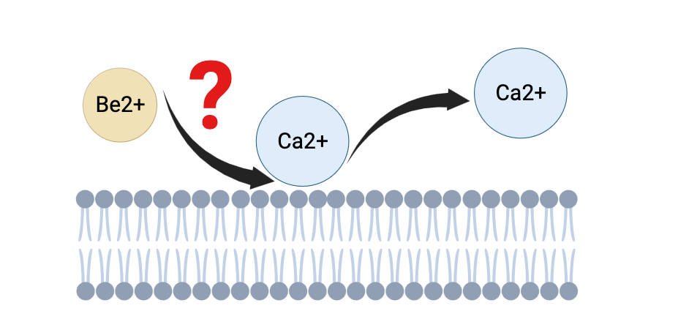
The Beryllium Cascade: From Phagocyte Inhibition to Granuloma
Fontenot, A. P. Annals of the American Thoracic Society 2018, 15
Be²⁺
Be²⁺
Ca²⁺
Ca²⁺
Ermakov, Y et al. Biochemistry 2017, 56 (40), 5457–5470.
Notes:
Be²⁺ inhibits phagocytosis of PS/PC-coated beads by macrophage-like IC-21 cells.

Slide 3
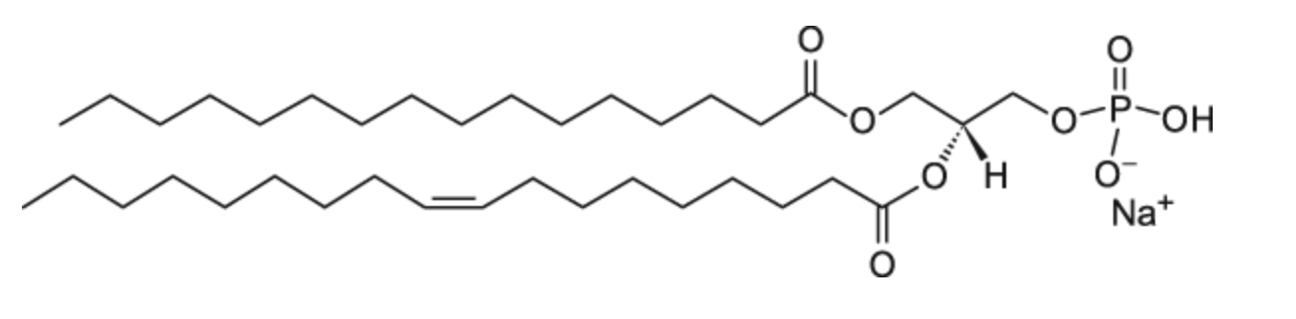
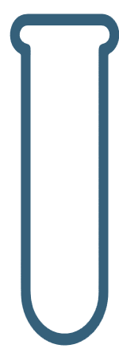
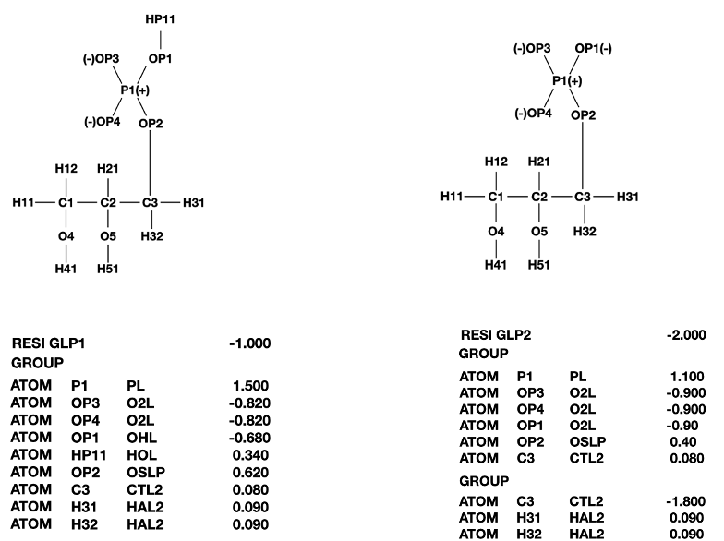
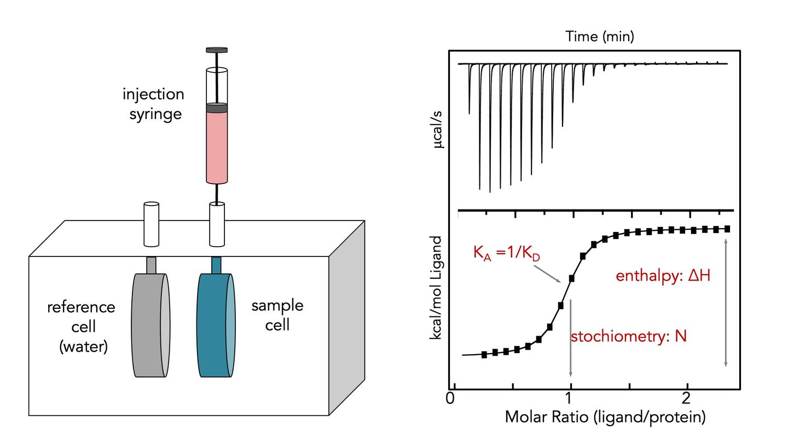
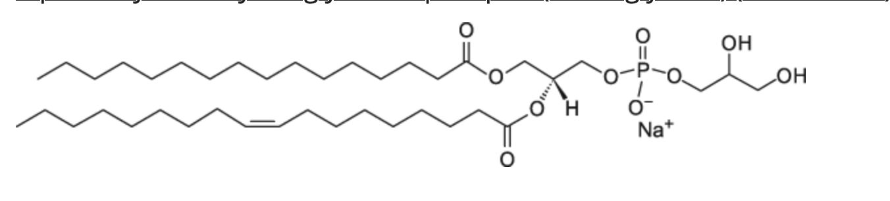
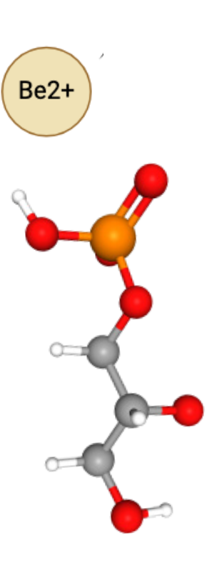
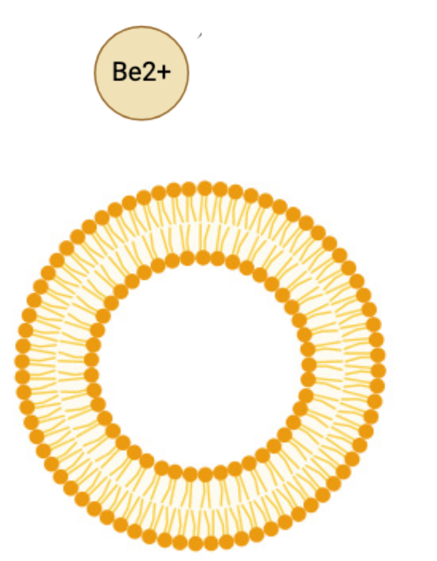
Isothermal Titration Calorimetry (ITC) Reveals Binding Strength
GLP1
GLP2
POPA lipid
POPG lipid
(Ion solution)
Be²⁺
Be²⁺
Ca²⁺
Ca²⁺
https://cmi.hms.harvard.edu/isothermal-titration-calorimetry

Slide 4
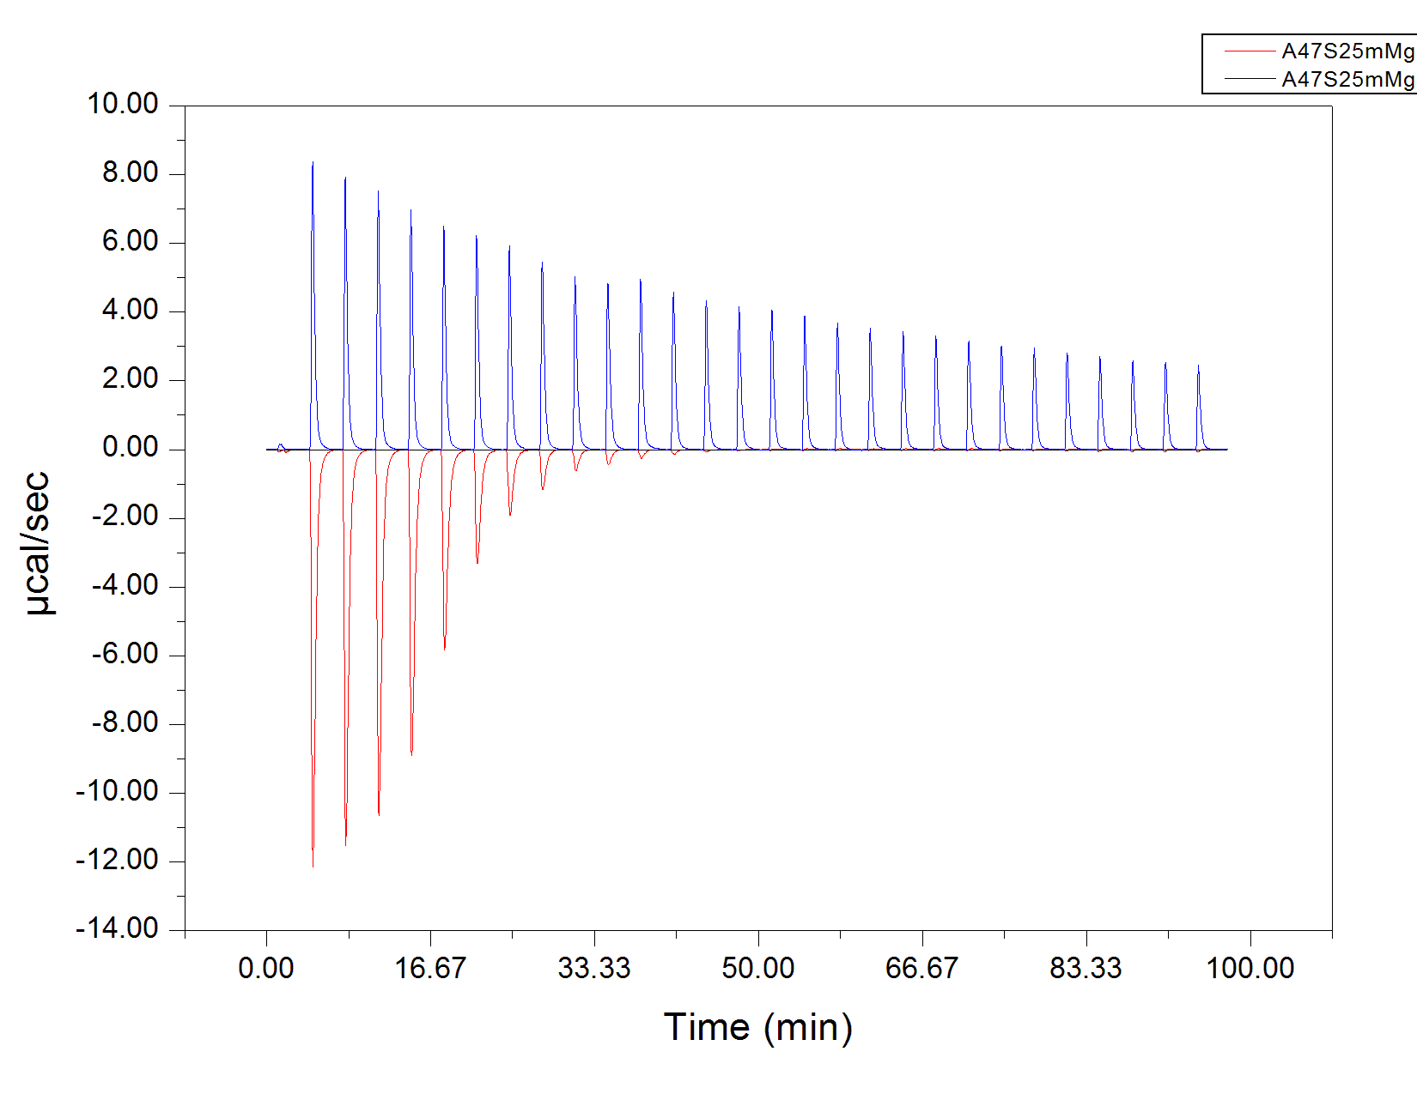
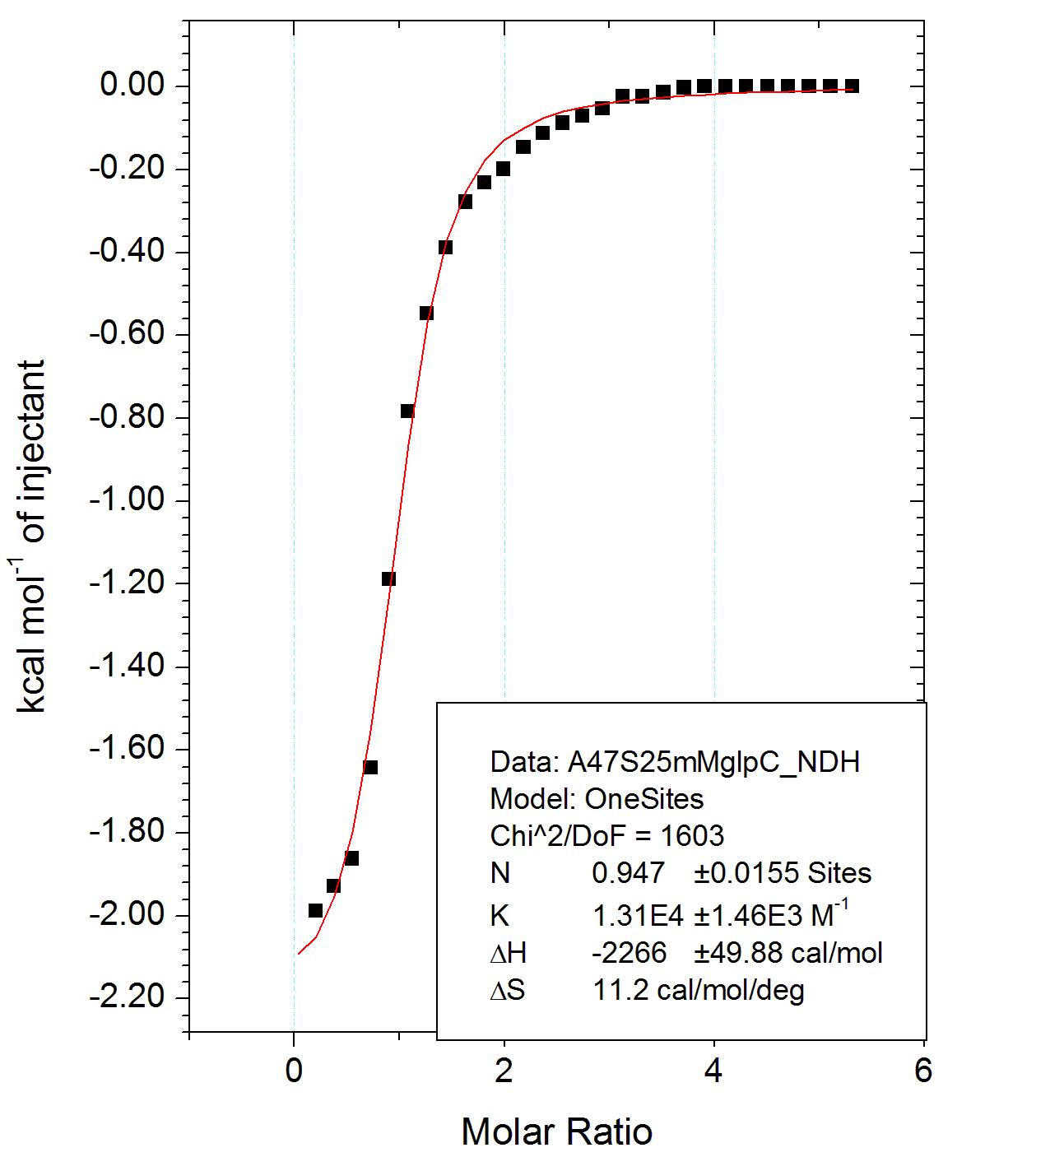
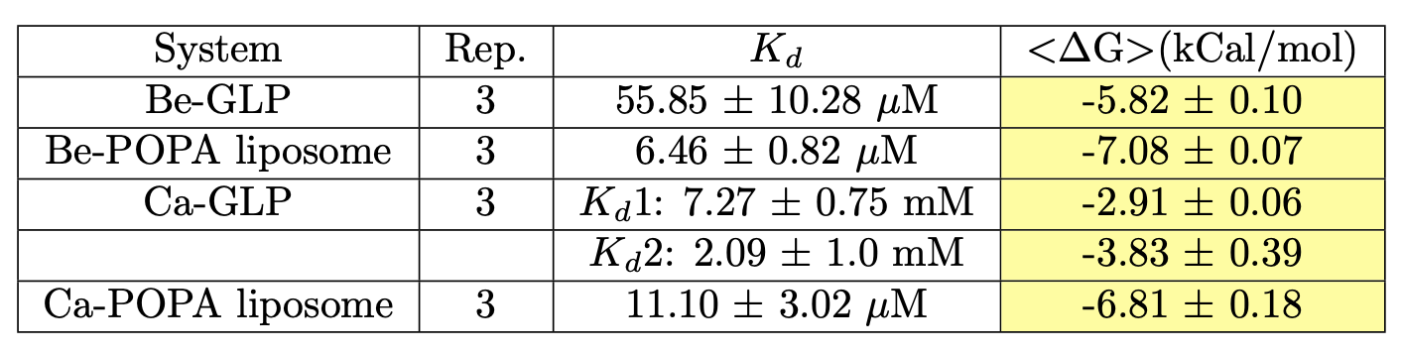
Experimental Data Confirms: Beryllium Binds Stronger Than Calcium
Experiment
Control
Heat data
Be²⁺

Slide 5
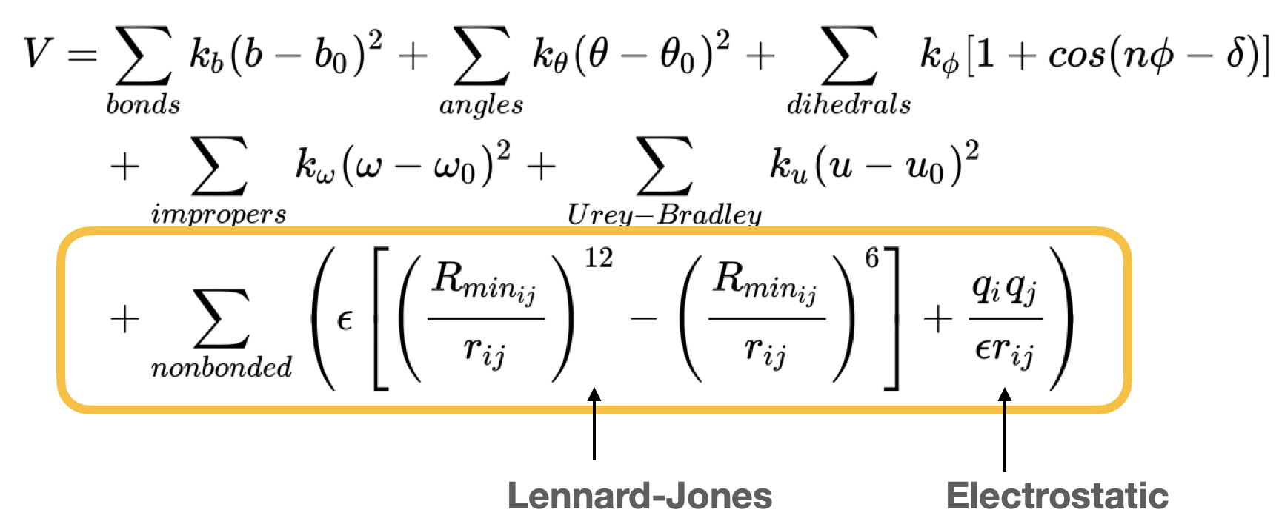
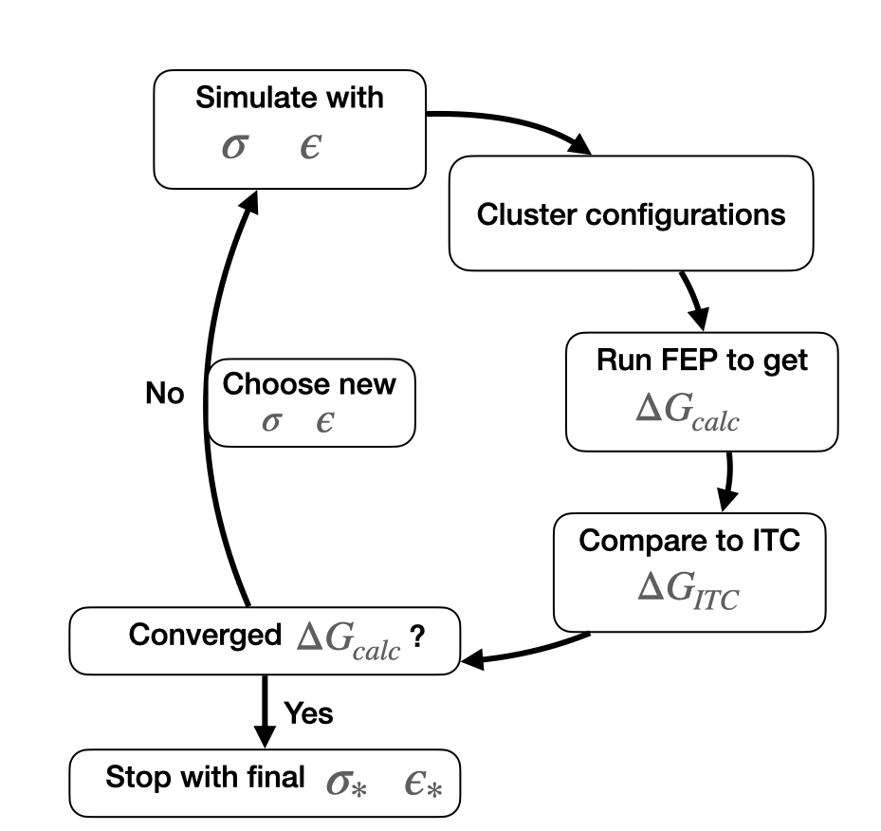
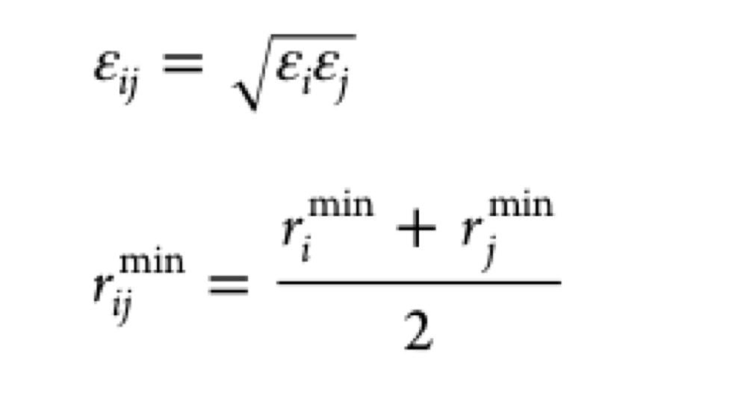
CHARMM forcefield
Optimisation pipeline
rmin
rmin
rmin*

Slide 6
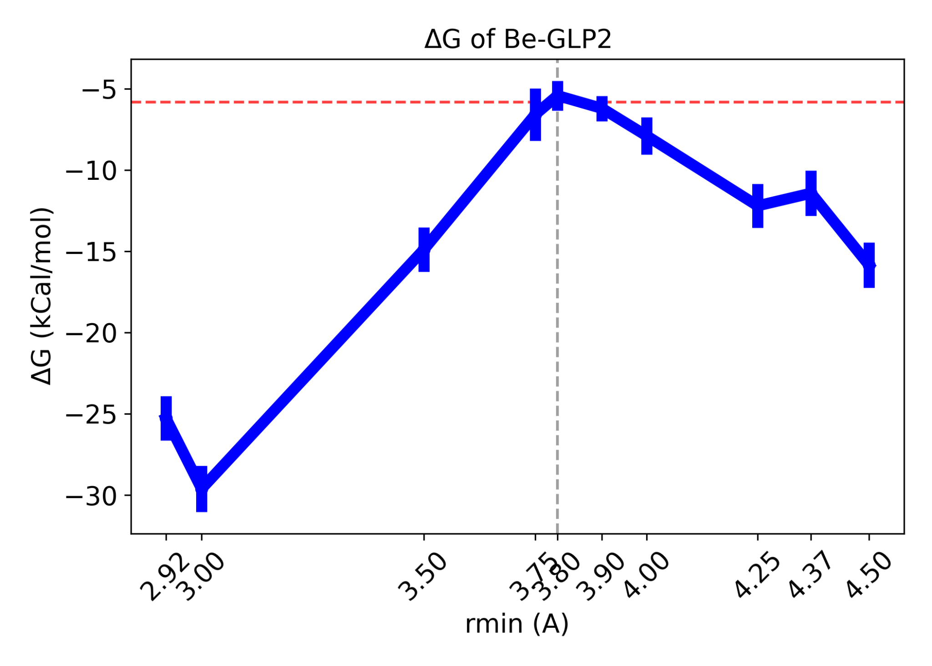
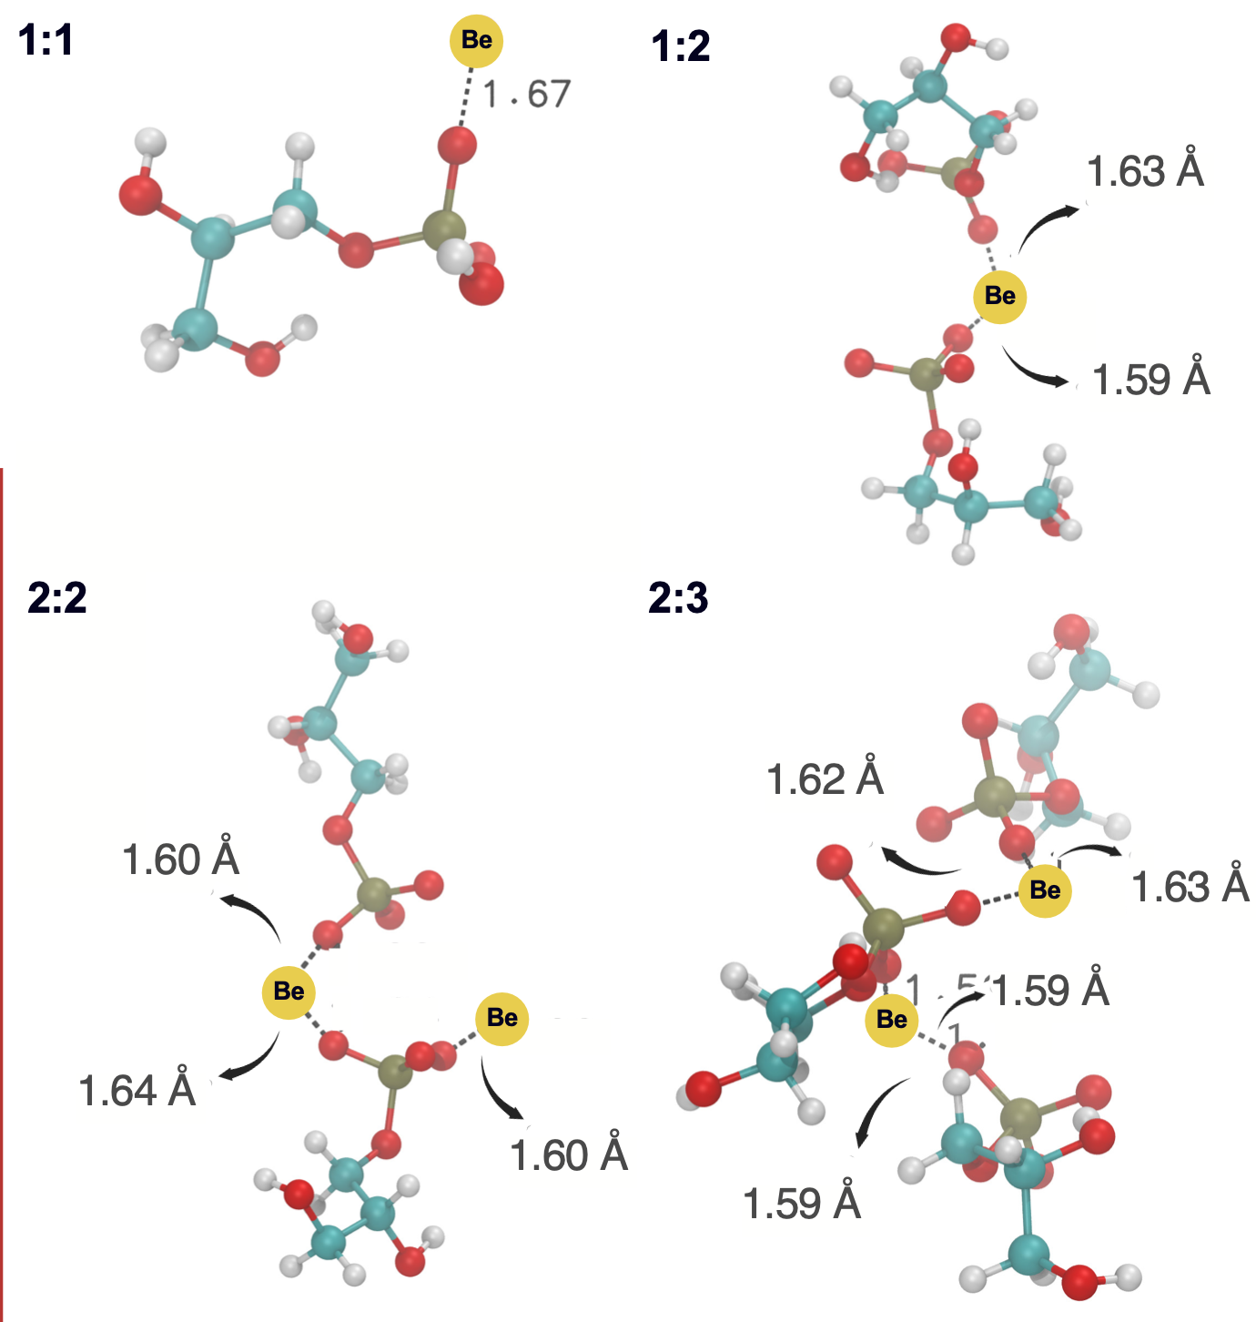
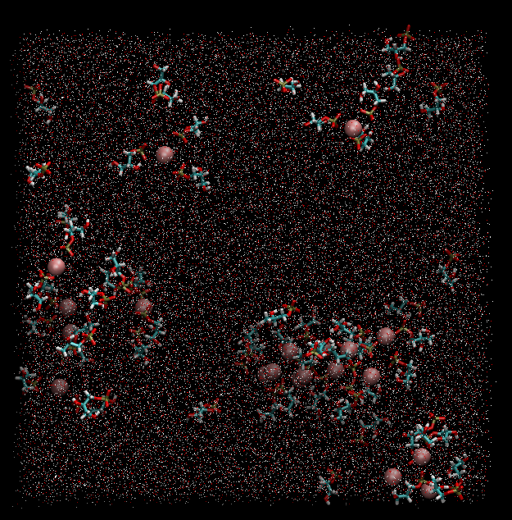
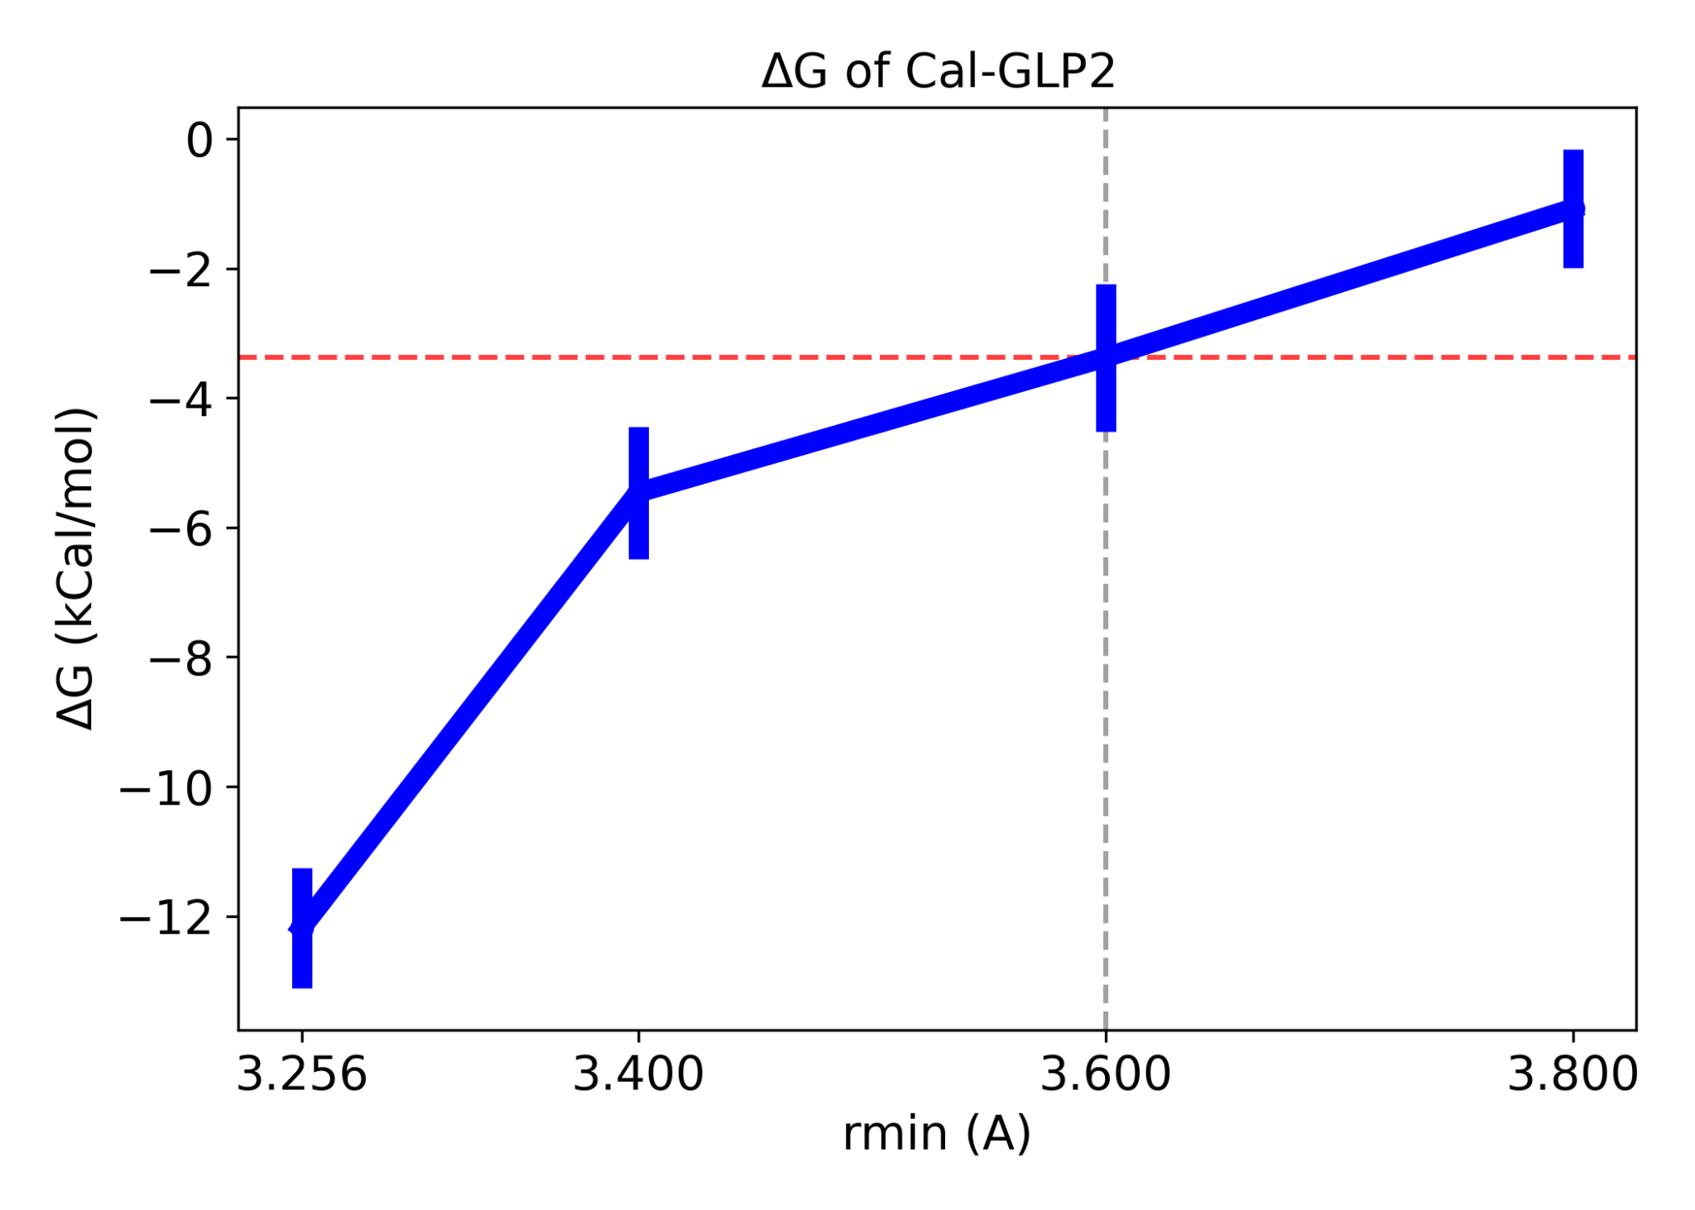
ΔG is highly dependent on first solvation shell
Be²⁺
Clustering (k-means)
FEP Thermodynamic Cycle
ΔG (kCal/mol)
*
Rmin (Å)
Ca²⁺
ΔG (kCal/mol)
*
Rmin (Å)

Slide 7
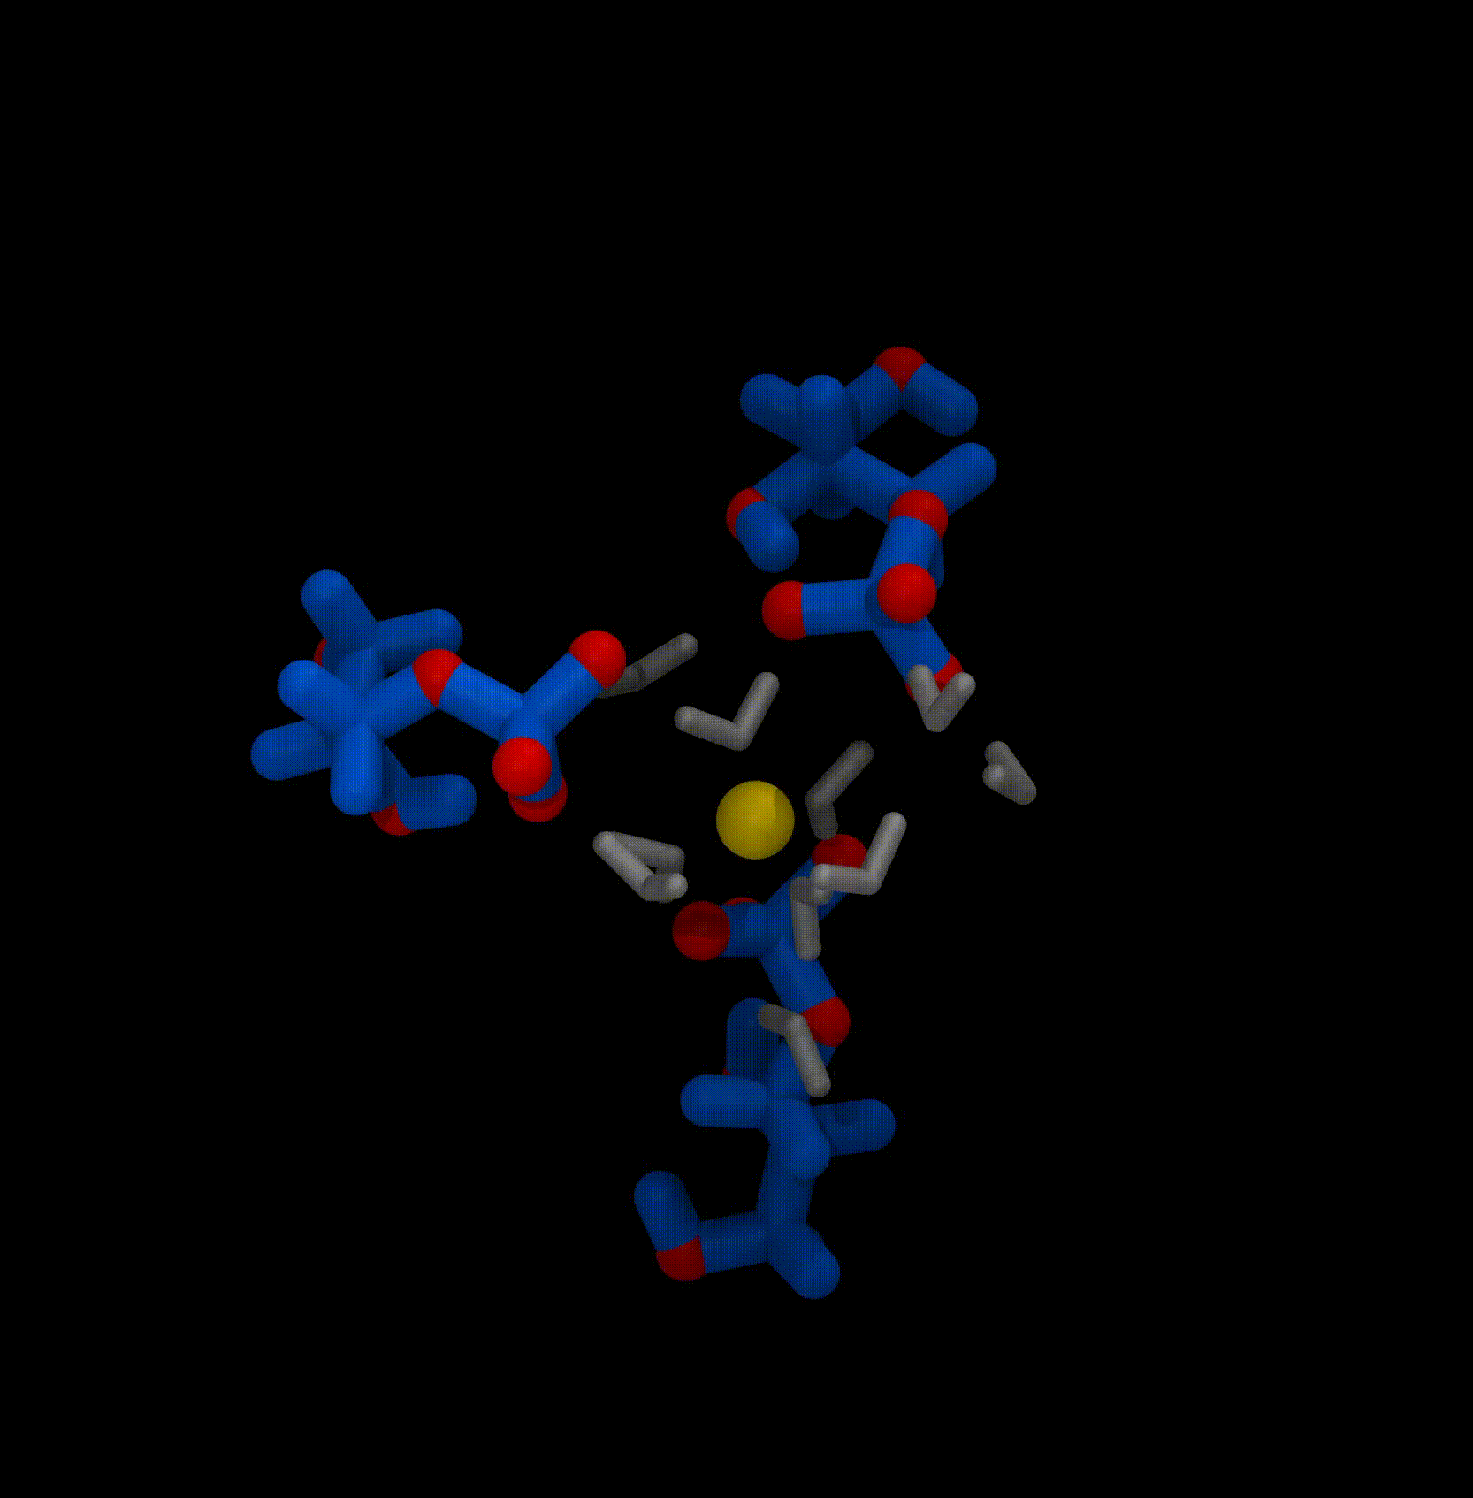
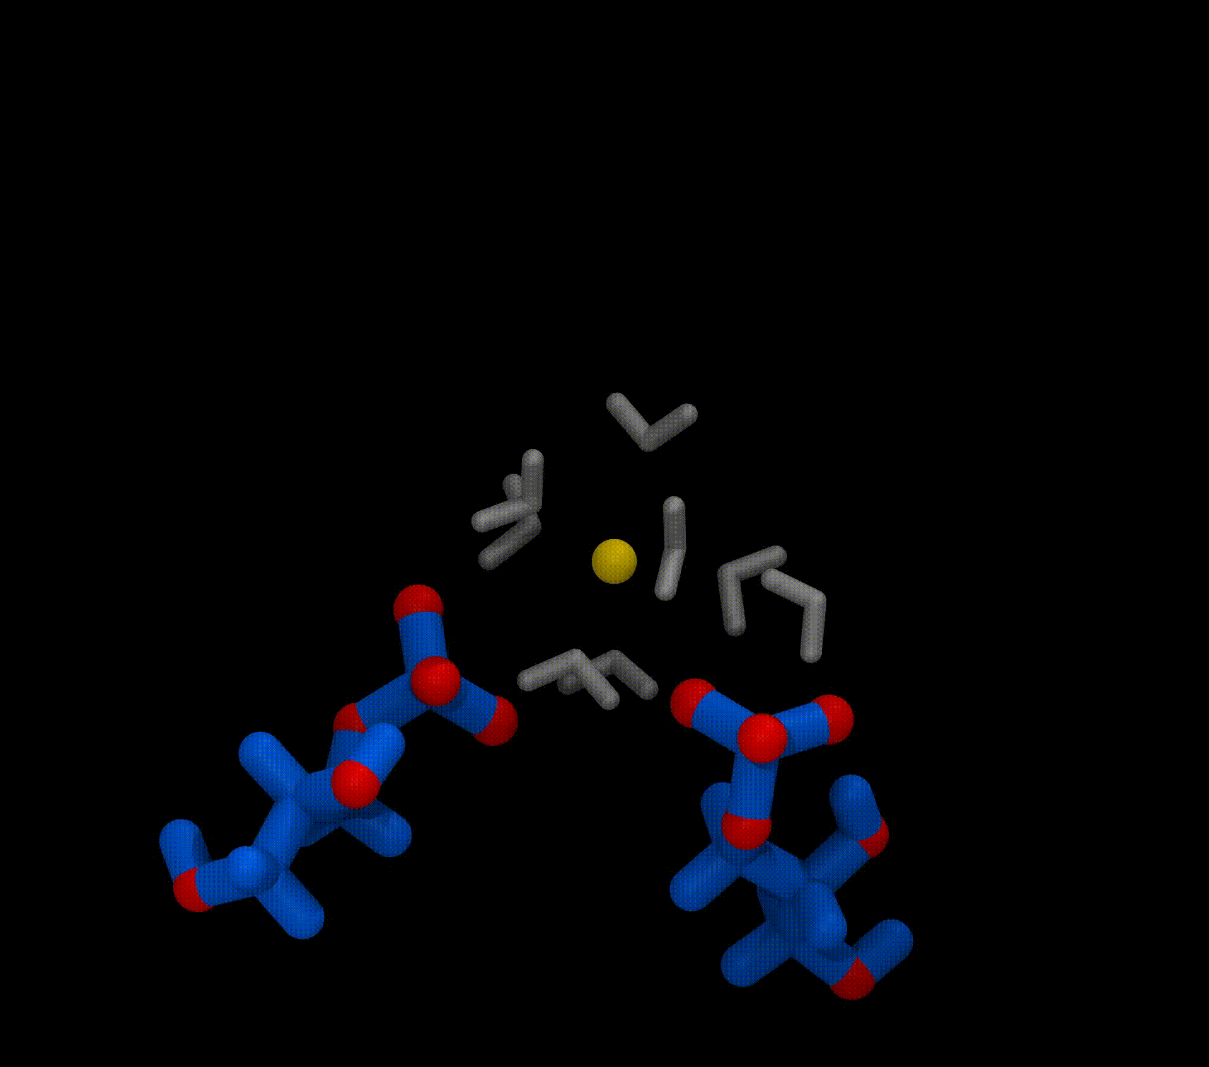
ΔG is highly dependent on first solvation shell
Be²⁺
Ca²⁺

Slide 8
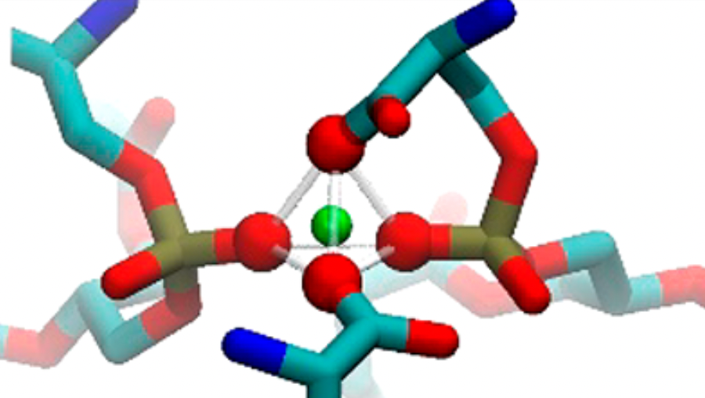
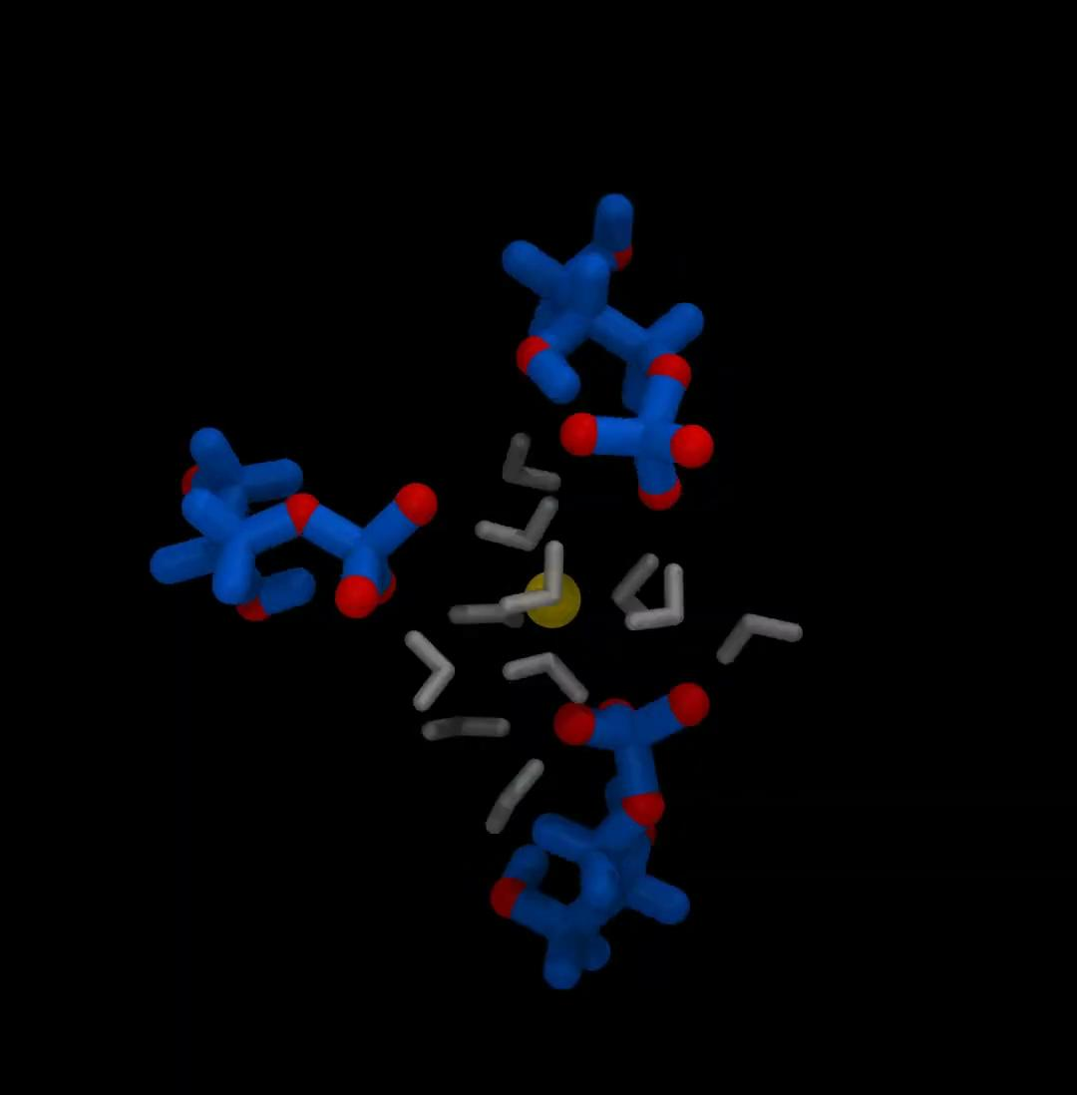

ΔG is highly dependent on first solvation shell
Be²⁺
Ca²⁺

Slide 9


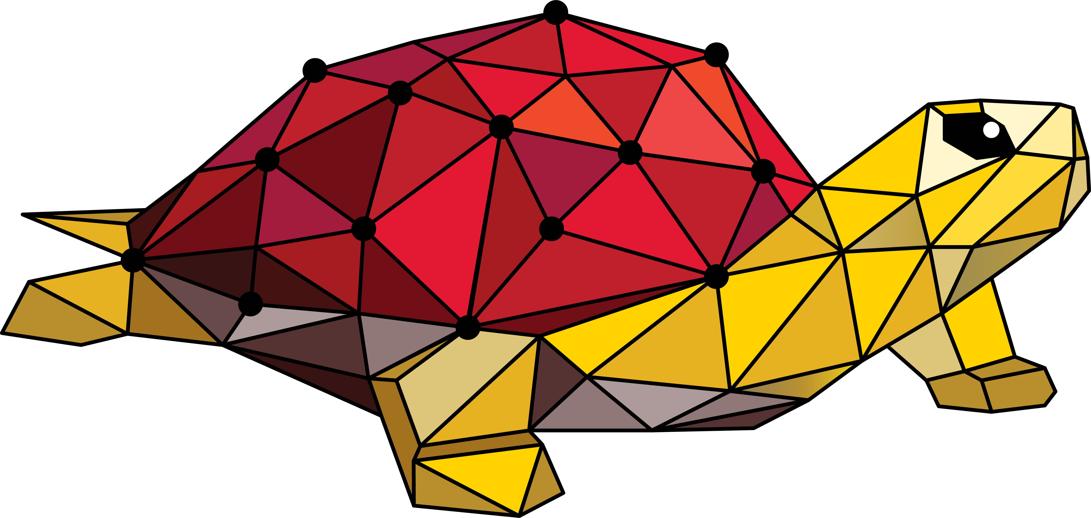
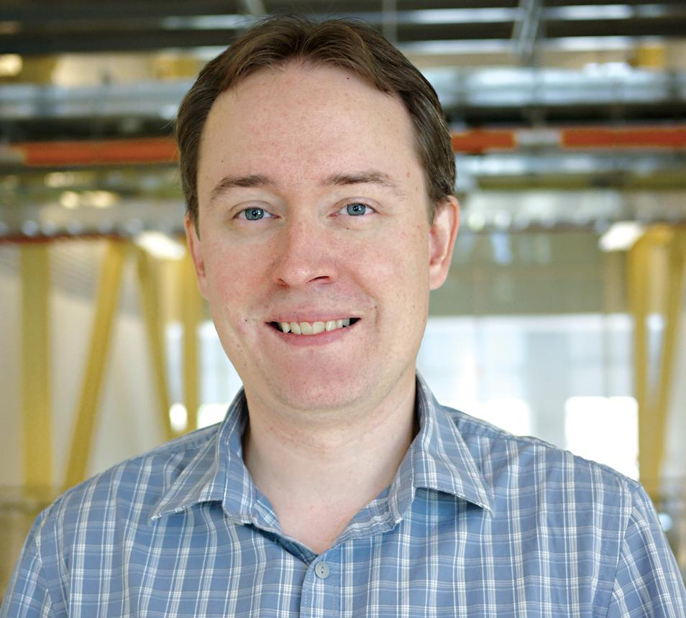
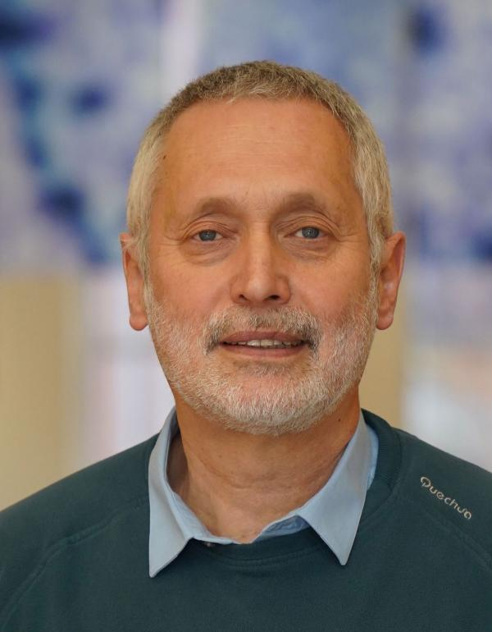
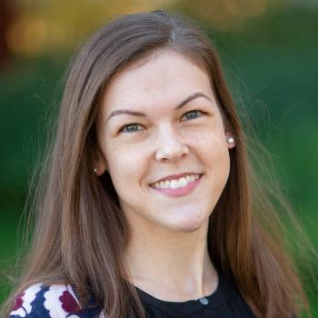
Main takeaway
Thank you!
Ca²⁺ is a weaker binder than Be²⁺ overall, affect protein-lipid interactions
Strong effect of first hydration shell on binding
Limitations of all-atom force field in representing highly polarizable systems
Contact
✉️ : jbodosa@umd.edu
🌐 : jbodosa.com
: https://github.com/jbodosa/config_clustering
Acknowledgements
Jeffery Klauda, UMD, College Park
Sergei Sukharev, UMD, College Park
Madolyn Britt, NIH, Bethesda
MDAnalysis Travel grant

